Slide 1
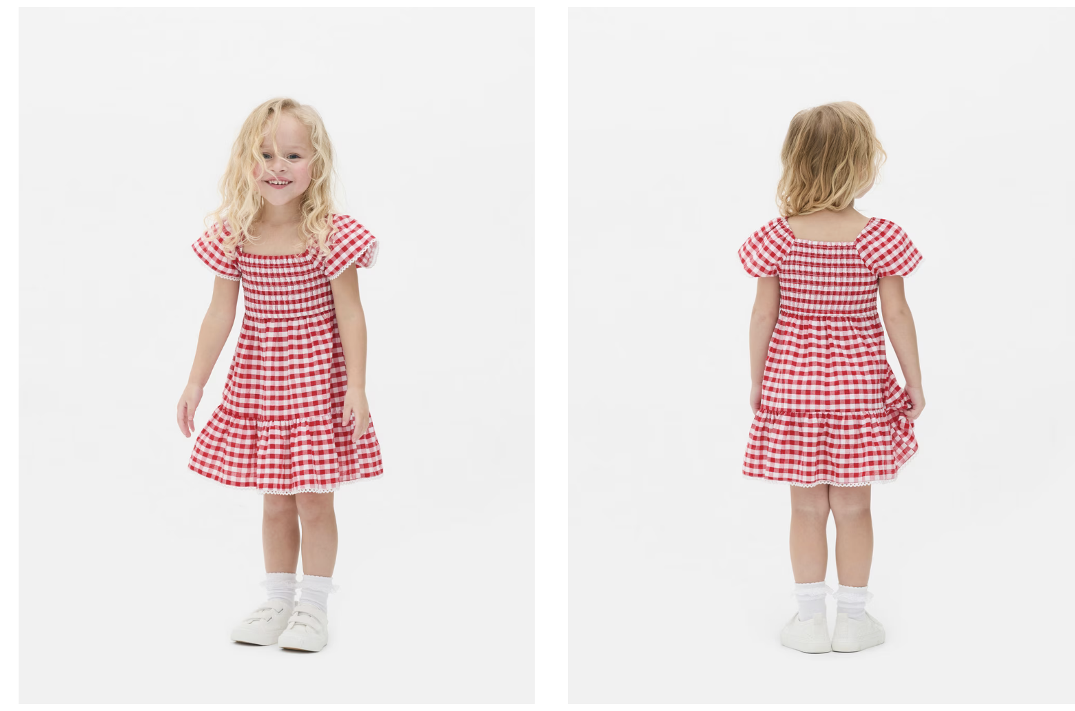
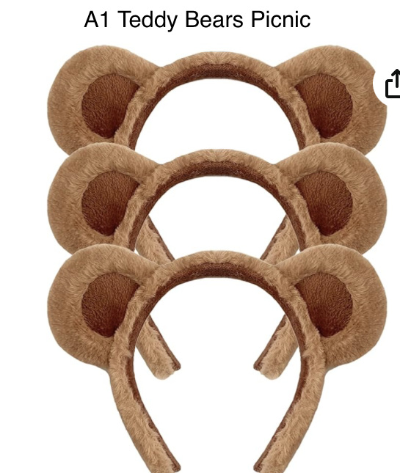
A1 Teddy Bears Picnic – Beginners Ballet
Pink ballet shoes
White socks with lace frill
Hair – Bunchies, with child’s hair colour bobbles.

Slide 2
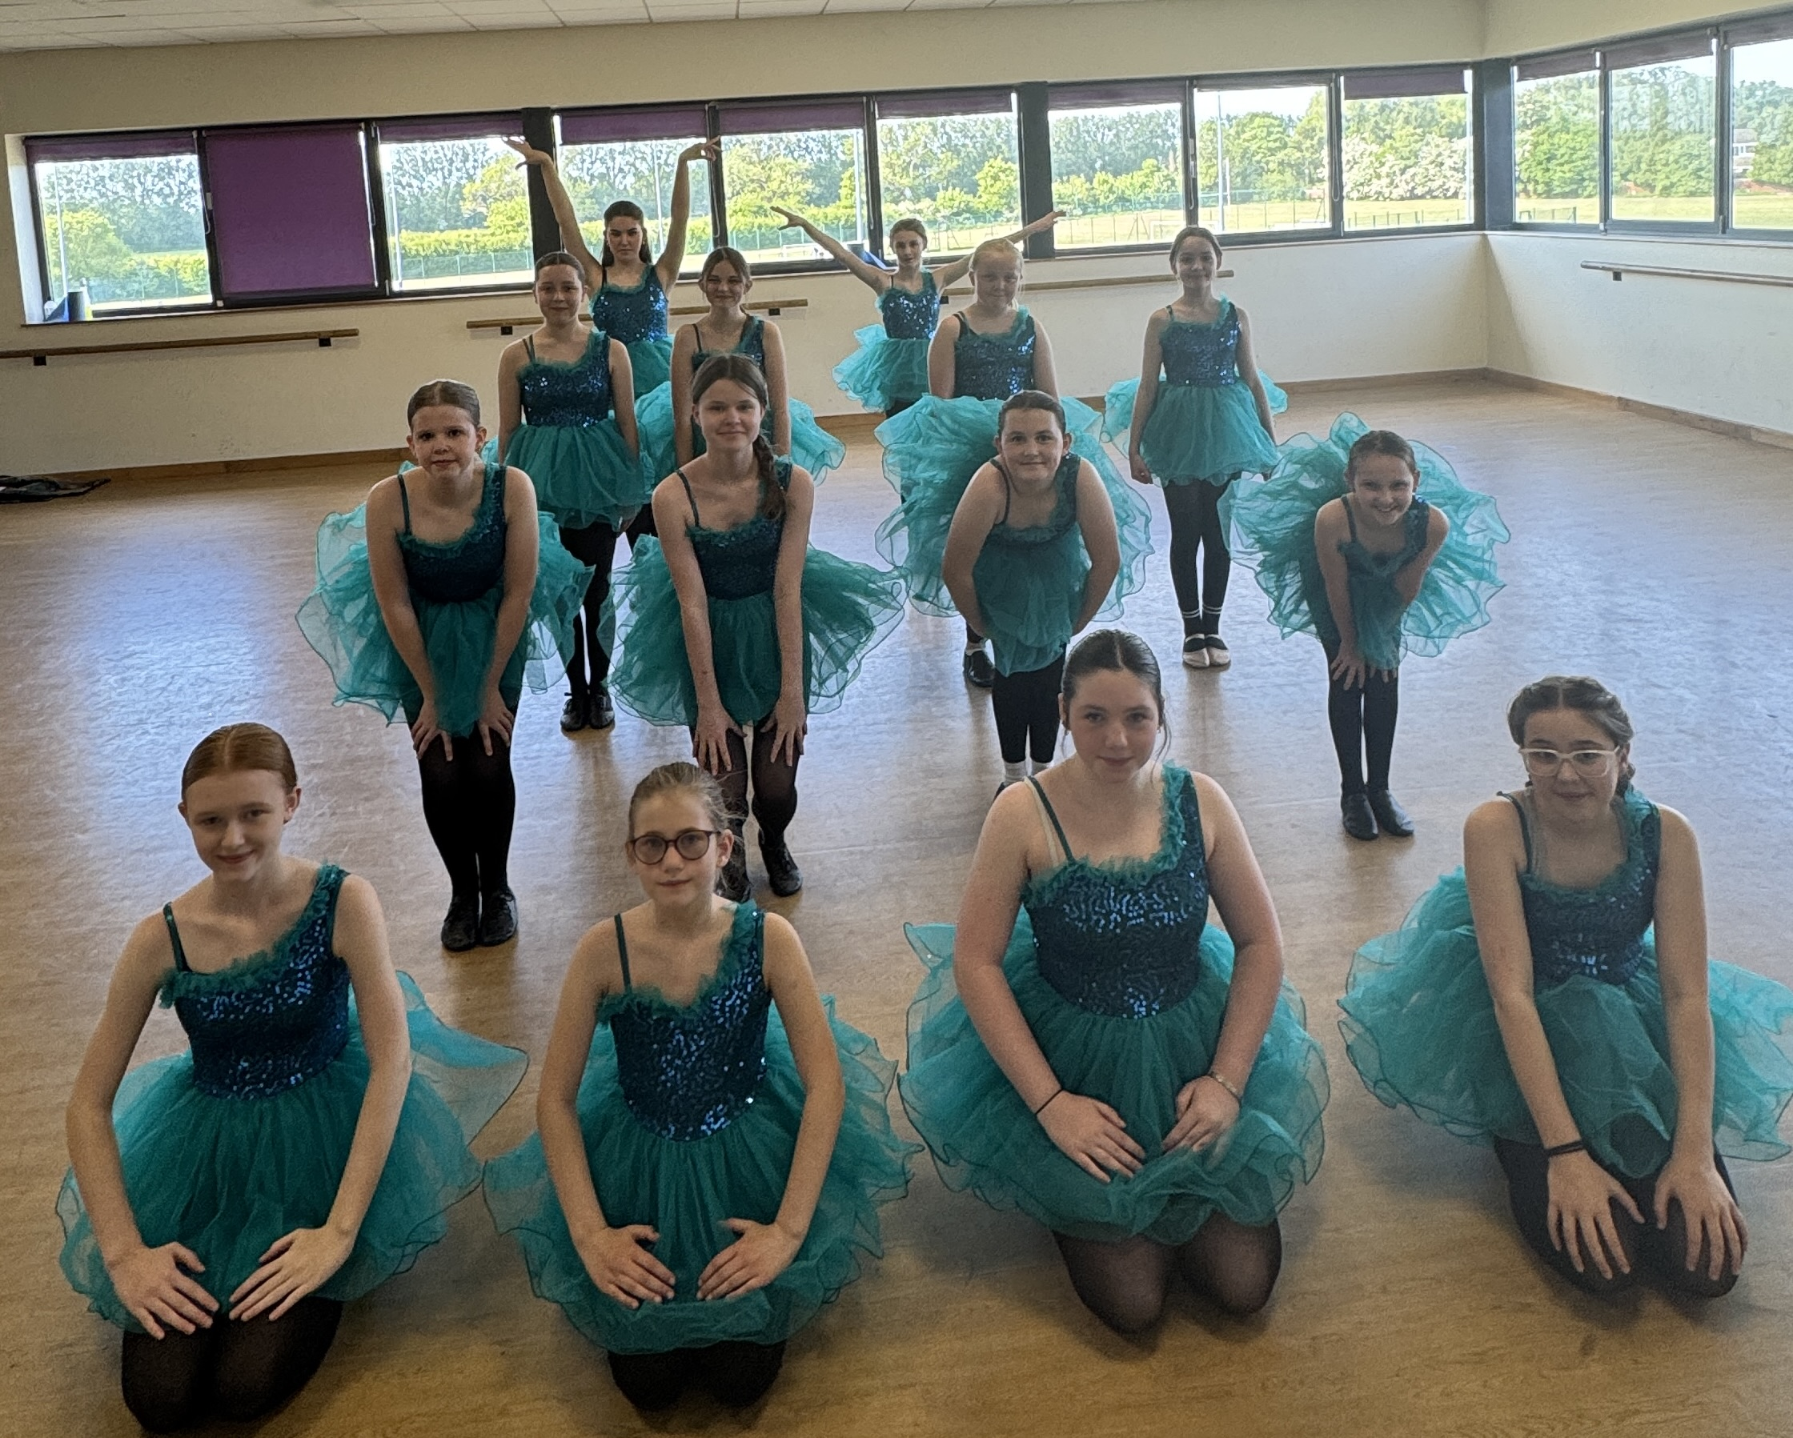
A2 The Emerald City - Grade 2 modern
Black full tights
Black Jazz/ballet shoes
Hair – pony
A2 Emerald City

Slide 3
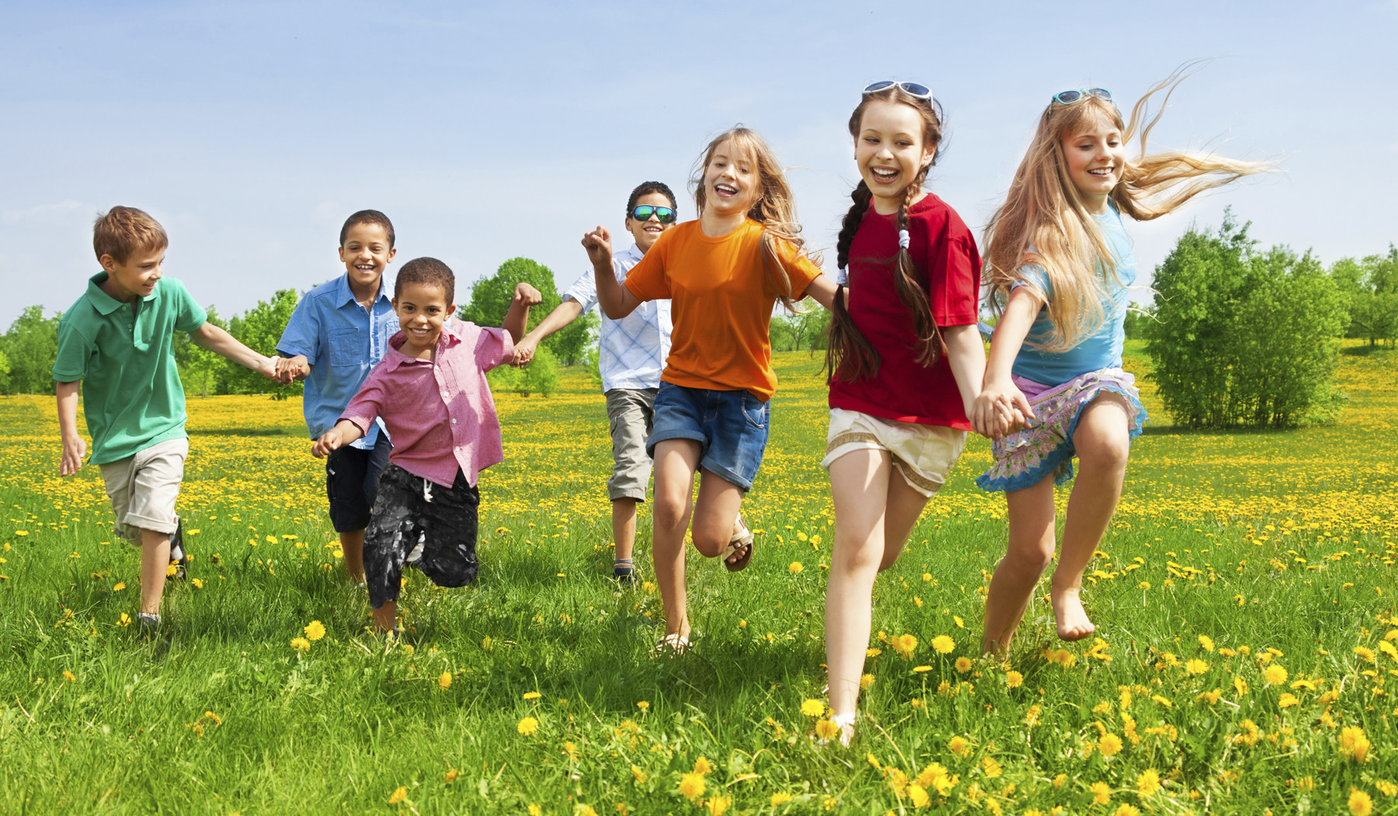
A3 Pied Piper-
Now children not Rats!!
Boys – Mark & Ezra
Shorts and t-shirt, any colour,
Black ballet shoes
Girls
Pretty dresses any style, above the knee in length.
Pink Ballet shoes
White socks with lace frill
Hair – tidy style
(Deposit has been returned to your account in Class manager)

Slide 4
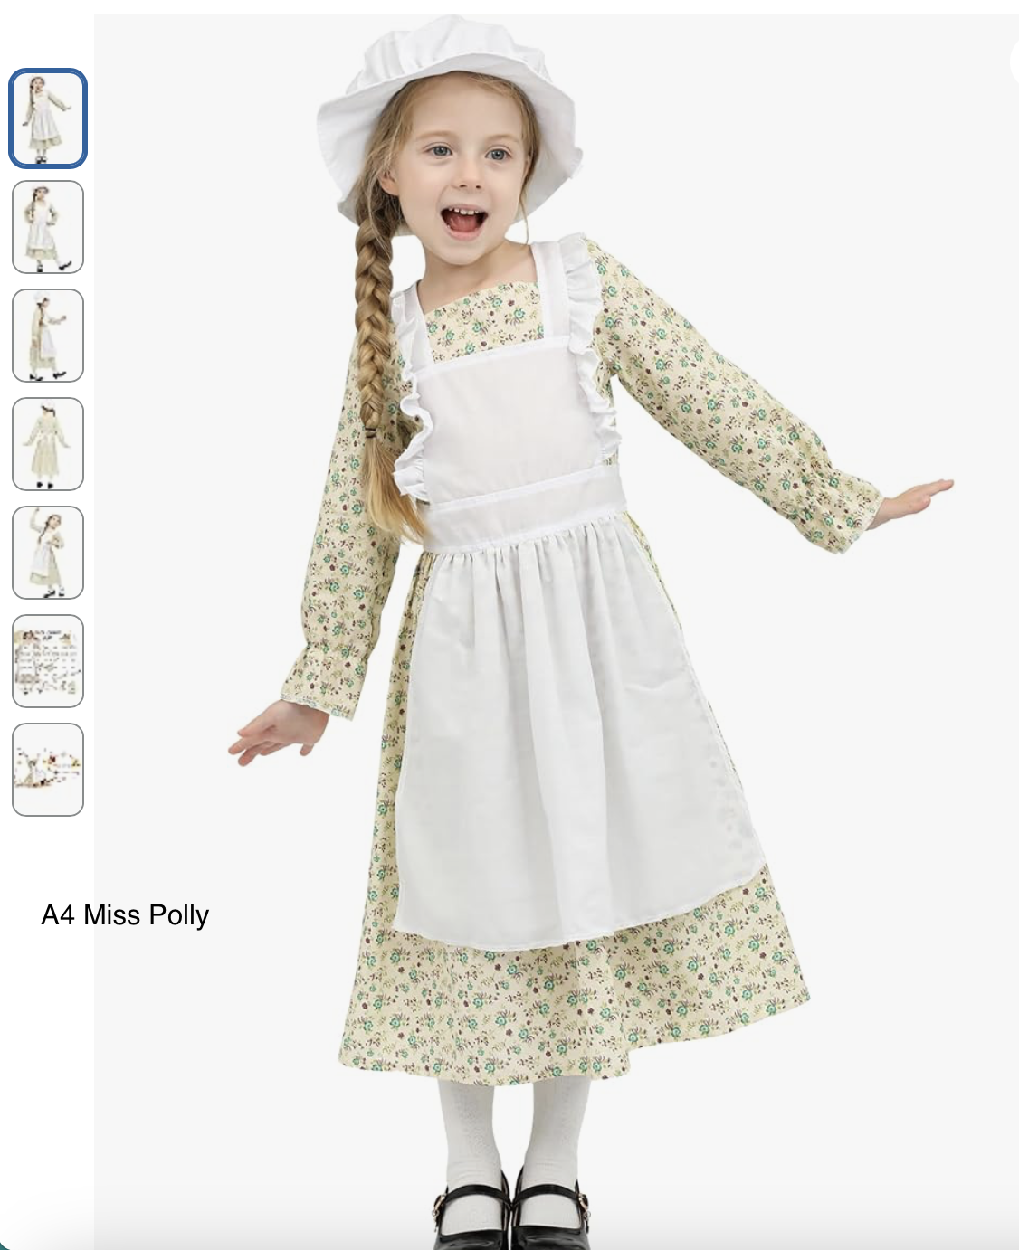
A4 Miss Polly – Brigstock beginners ballet
Pink ballet shoes
White socks with lace frill
Hair – Two plaits

Slide 5
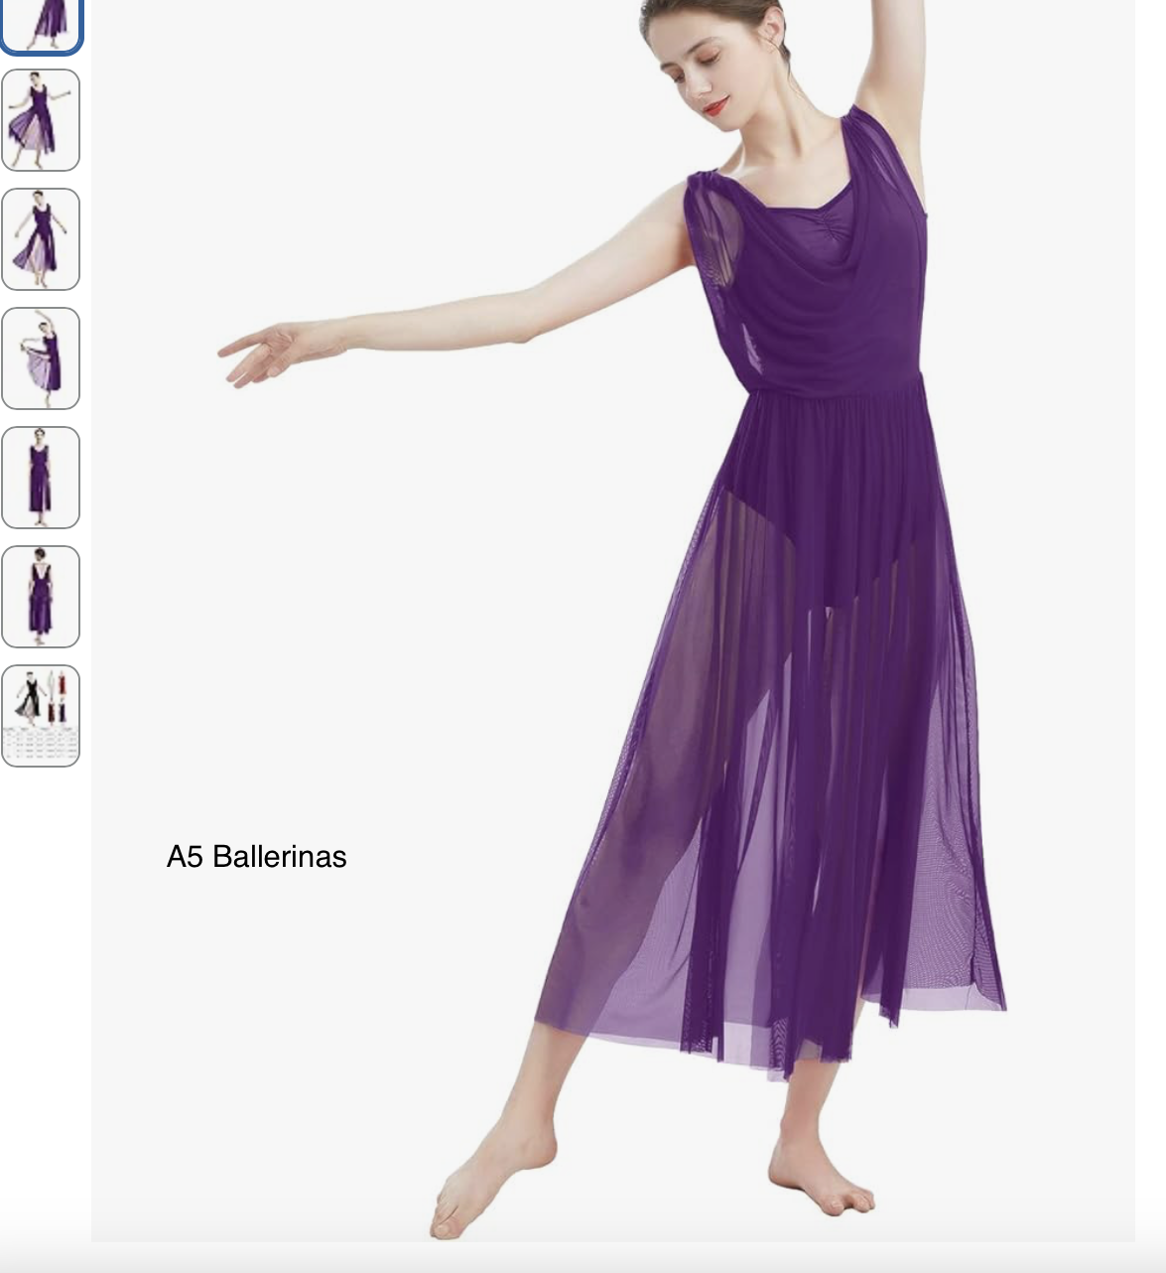
A5 Ballerinas – Senior ballet
Pink shoes
Pink footed tights
Hair – up for discussion
* Alfie to discuss in class

Slide 6
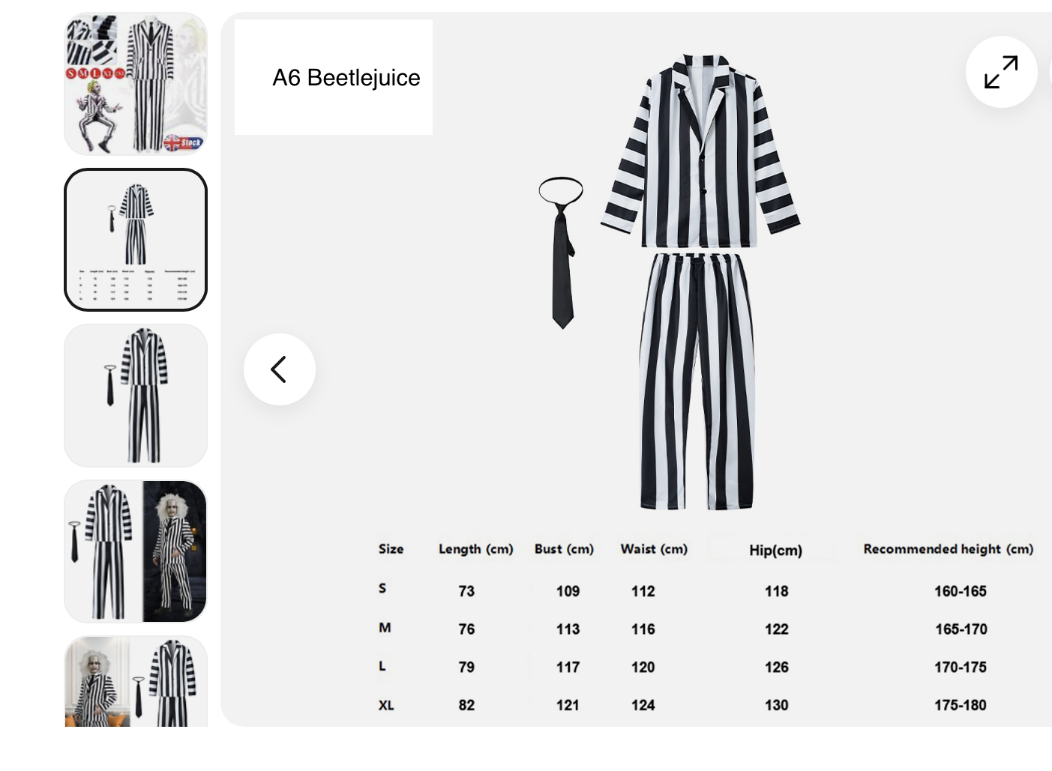
A6 Beetlejuice – Grade 3 modern
Black Jazz shoes
Vest top – included with suit
Black socks
Hair – pony

Slide 7
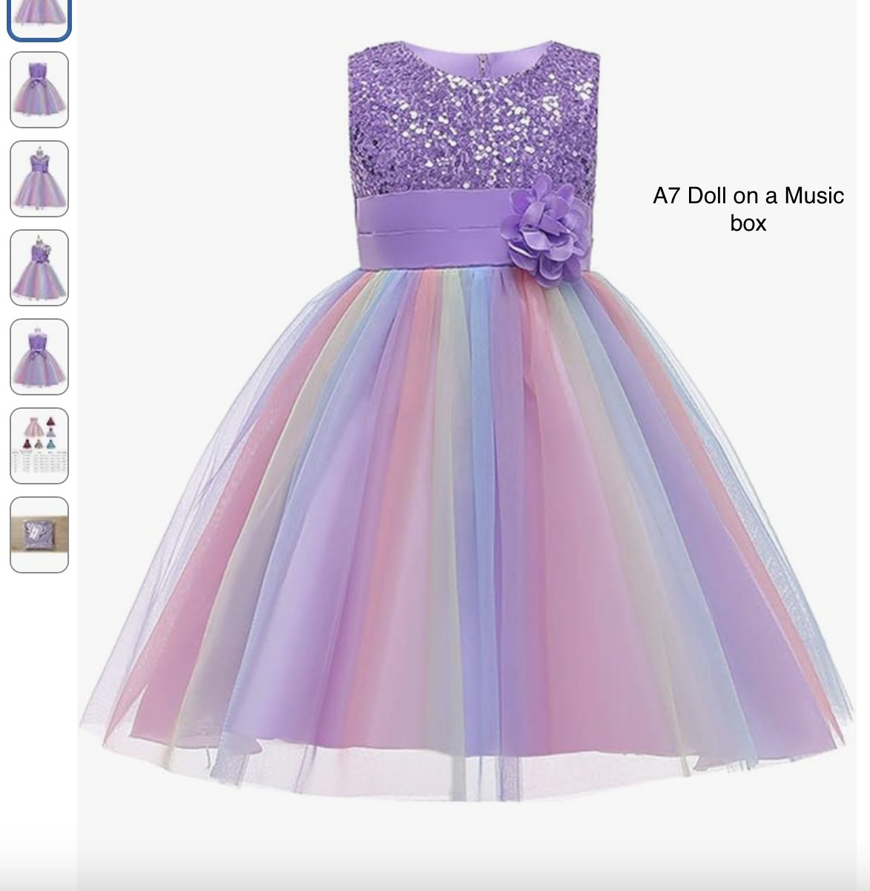
A7 Doll on a Music Box – Class Ballet
Pink ballet shoes
White ankle socks with lace frill
Hair – Ballet buns

Slide 8
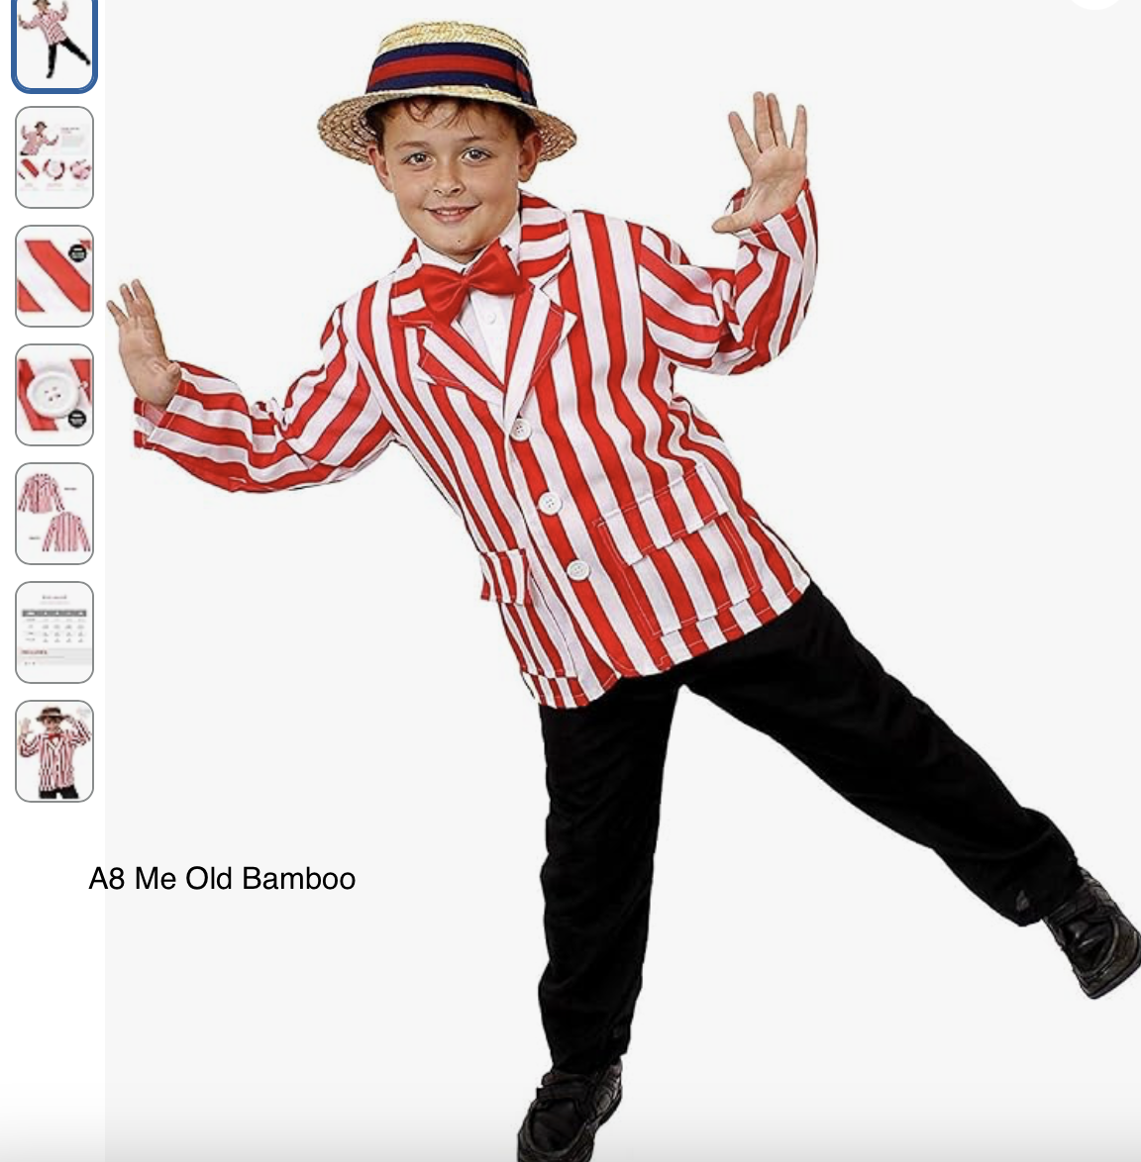
A8 Me Old Bamboo – Grade 1 modern
Black Leotard
Black footless tights
Black dance shorts
Pink ballet shoes
Hair – two plaits
Hats not included

Slide 9
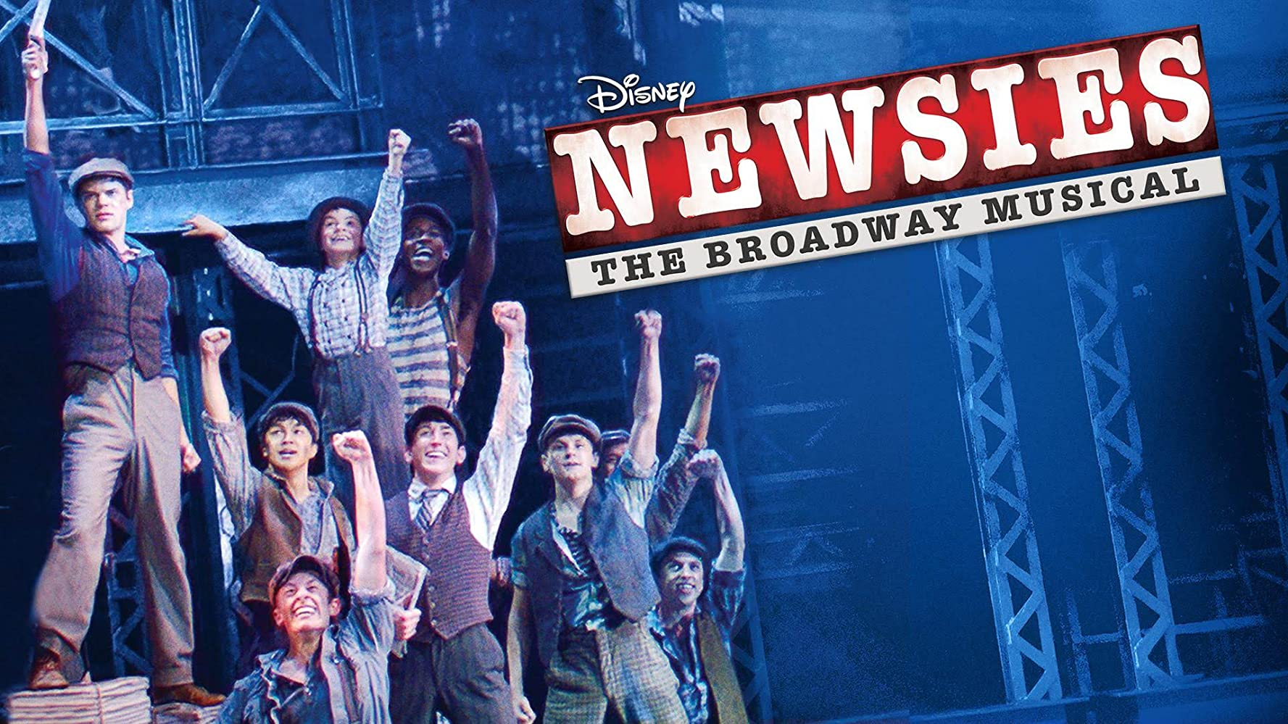
Newsies
Find your own costume
Jeans
Checkered shirt
Tap shoes
Hair – to be discussed
(Deposit has been returned to your account in Class manager)
This Photo by Unknown Author is licensed under CC BY-NC

Slide 10
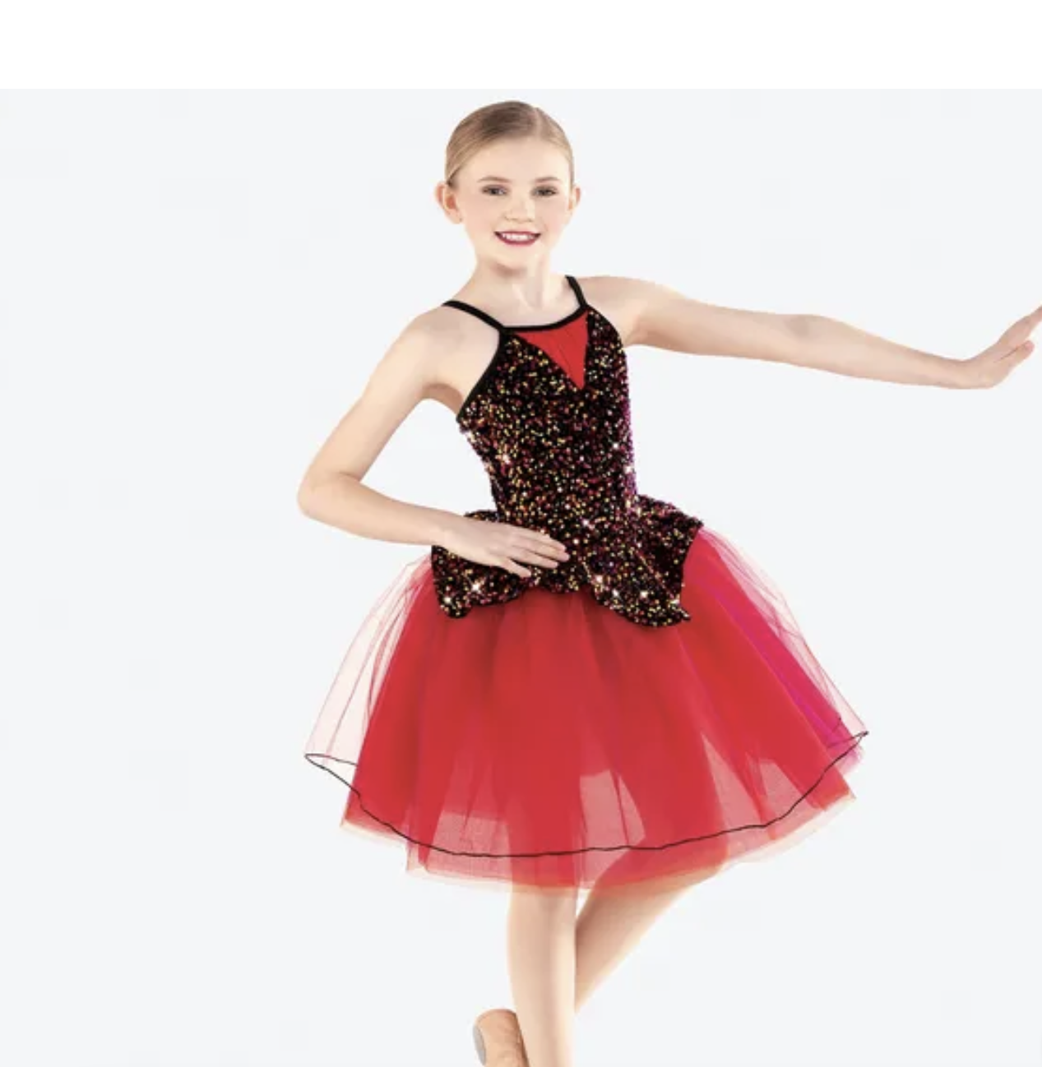
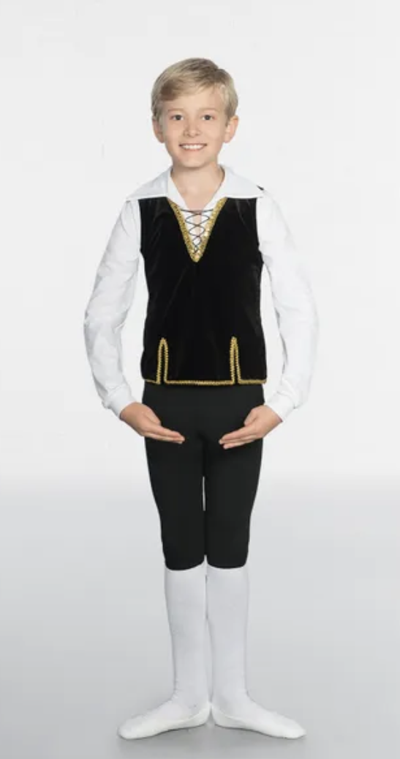
A10 Tarentella – Grade 3 Ballet
Pink ballet shoes
Pink footed tights
Hair – to be discussed
A10 Tarentella
Corey – Black leggings and a white tshirt

Slide 11
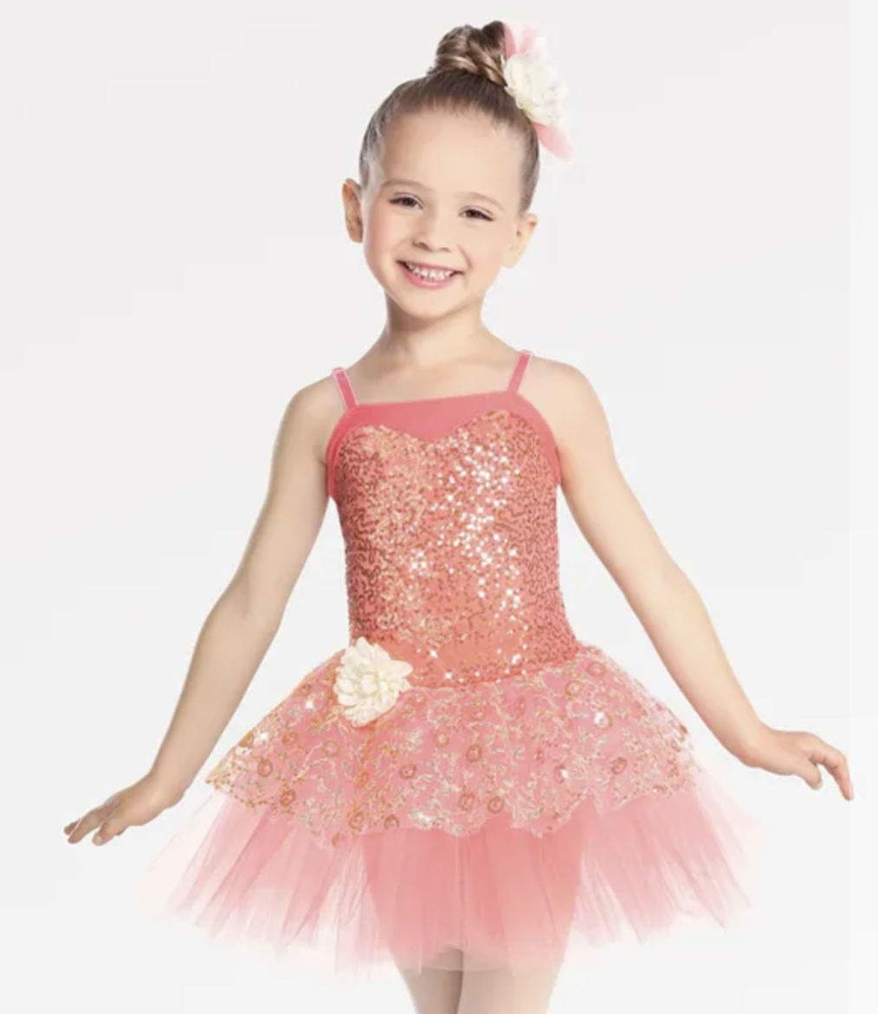
A11 In an English Country Garden – prelim ballet
Pink ballet shoes
White socks with lace frill
Hair – Ballet buns
A11 In an English Country Garden

Slide 12
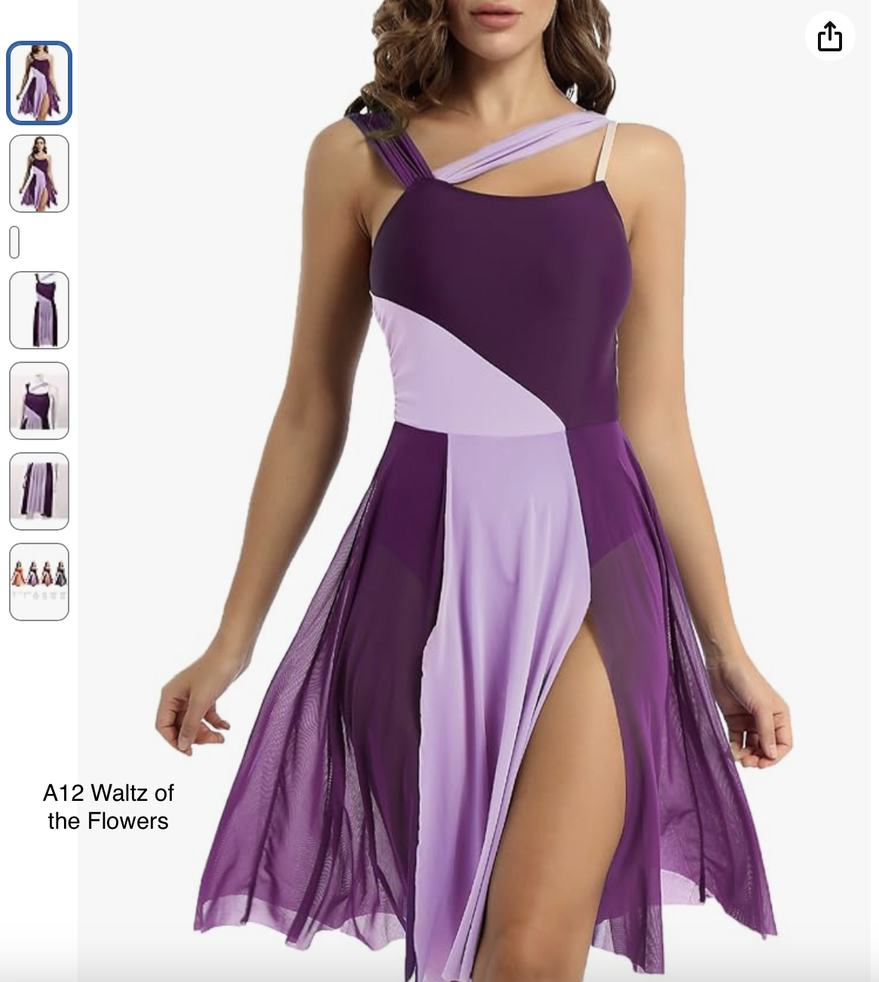
A12 Waltz of the flowers – Grade 5 ballet
Dress may be in the colours we discussed
Pink ballet tights
Pink ballet shoes
Hair – to be discussed

Slide 13
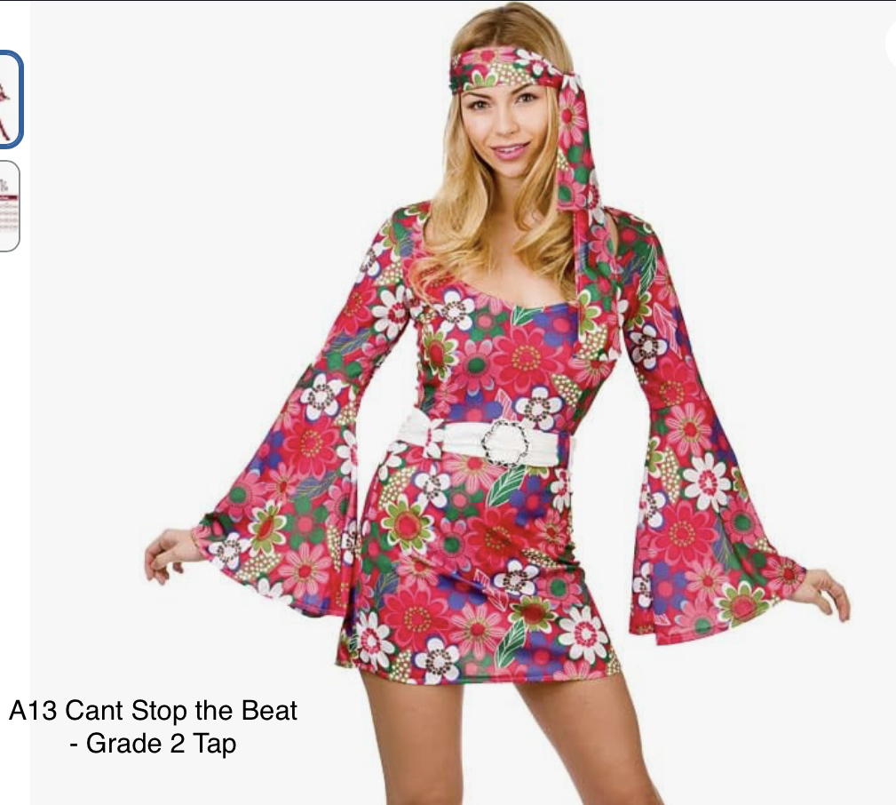
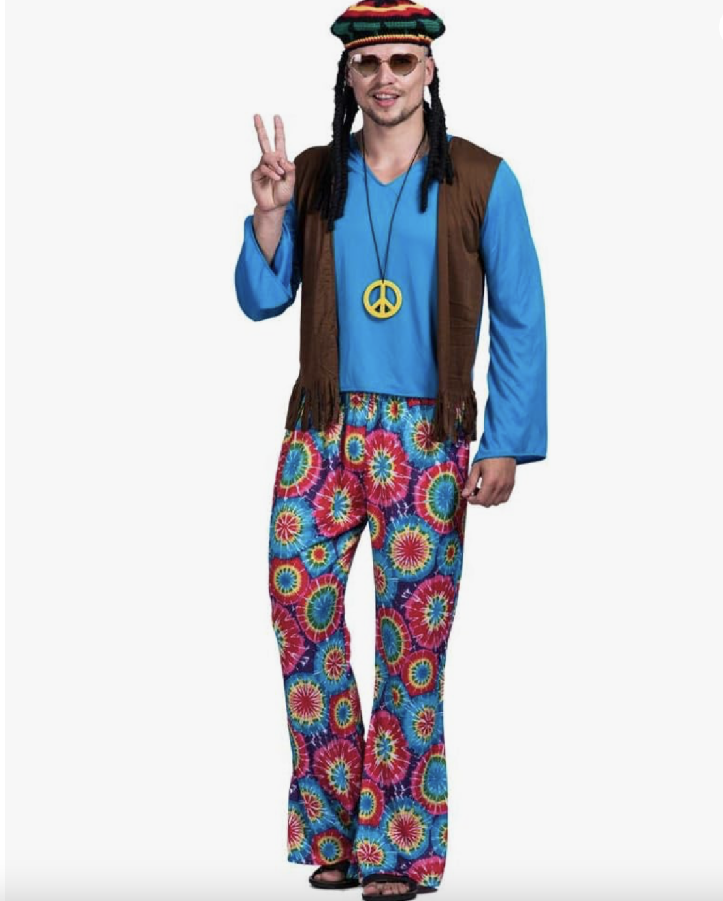
A13 Can’t Stop the Beat – Grade 2 tap
Black tap shoes
Flesh tights
Black dance shorts
Hair- high pony

Slide 14
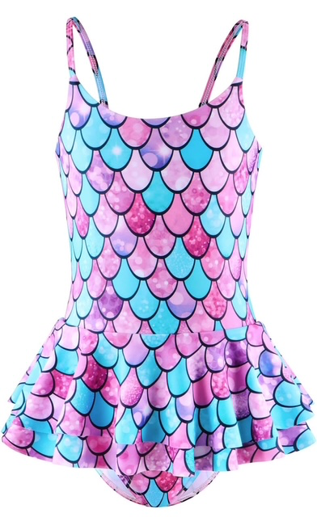
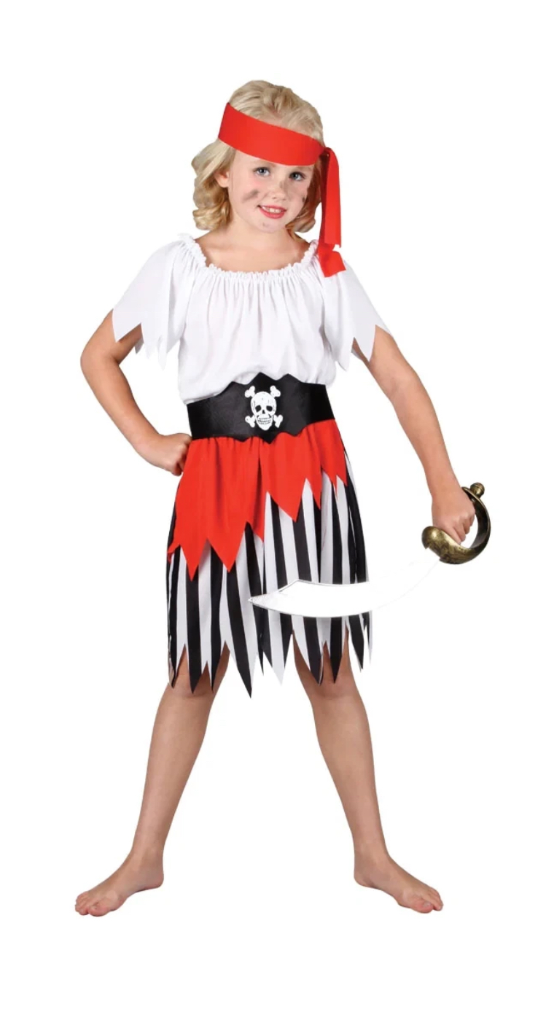
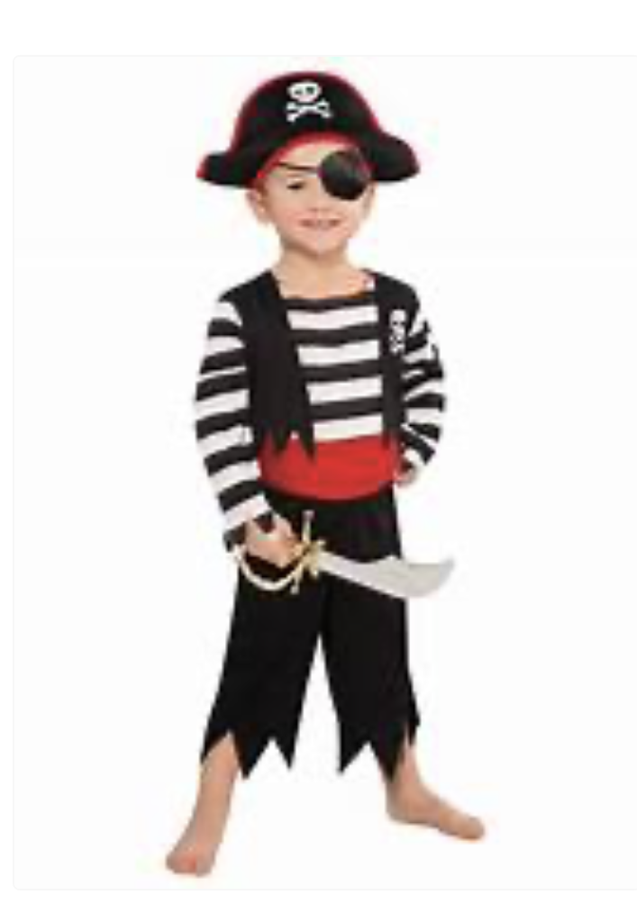
A14 Pirates & Mermaids – Beginners & Class Tap
Mermaids
Black tap shoes
White socks with lace frill
Hair - Bunchies
Pirates
Black tap shoes
White ankle socks with lace frill
Hair ballet Bun

Slide 15
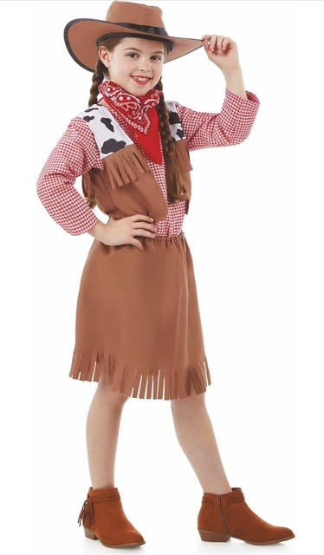
B1 Cowgirls – Prelim tap
Black Tap Shoes
White ankle socks with lace frill

Slide 16
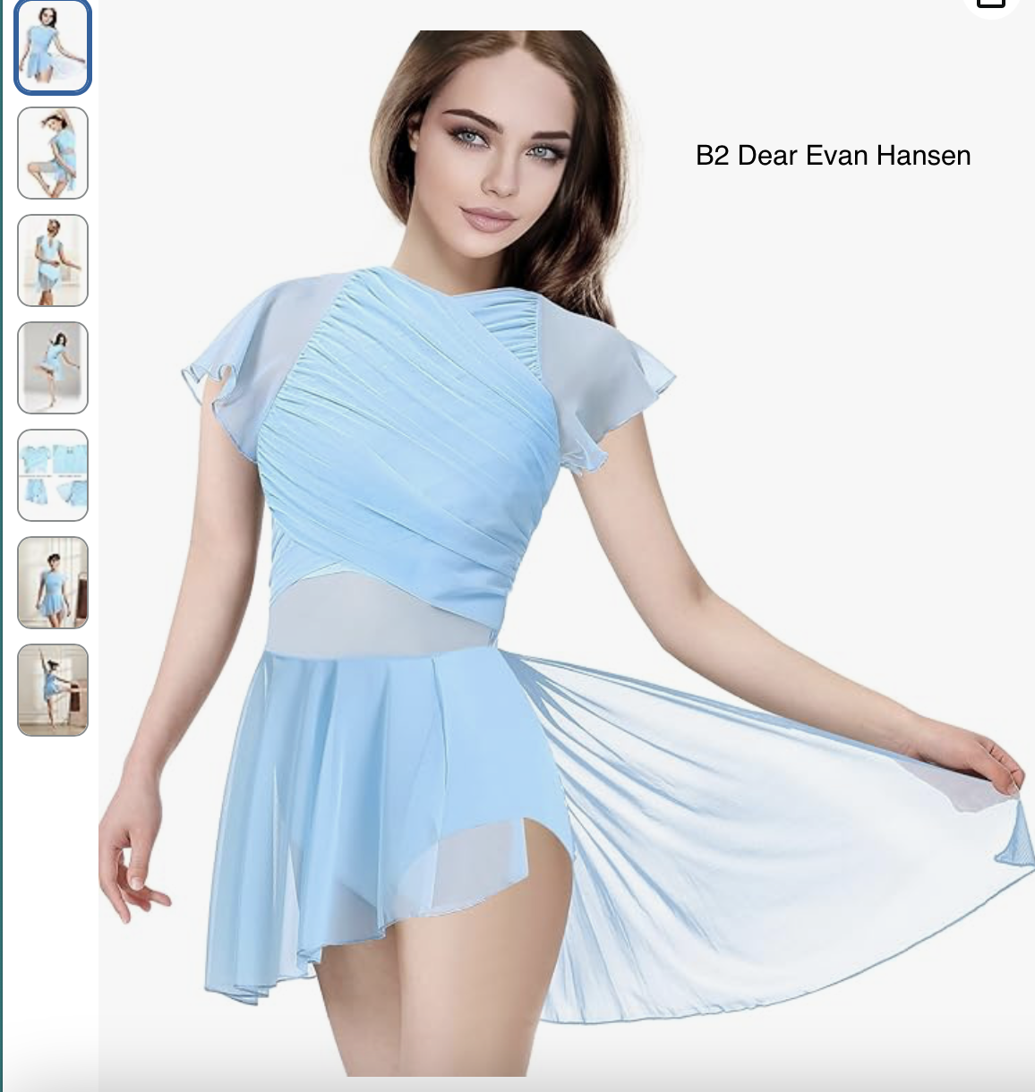
B2 Dear Evan Hansen – Brigstock Grade 2 & 3 Ballet
Pink ballet shoes
Pink ballet tights
Hair – Ballet bun

Slide 17
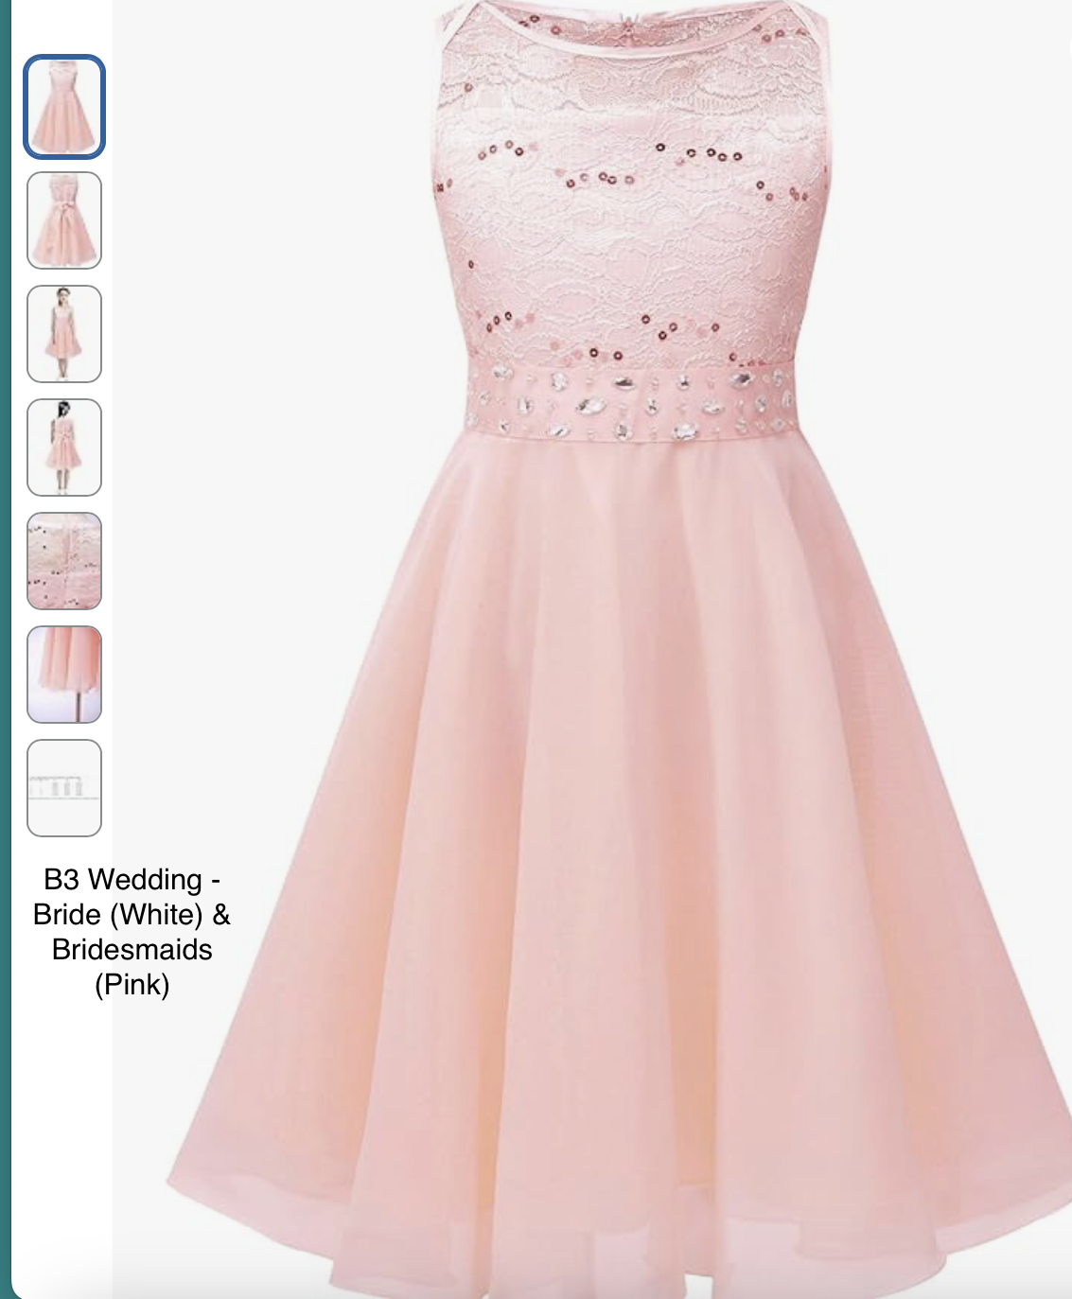
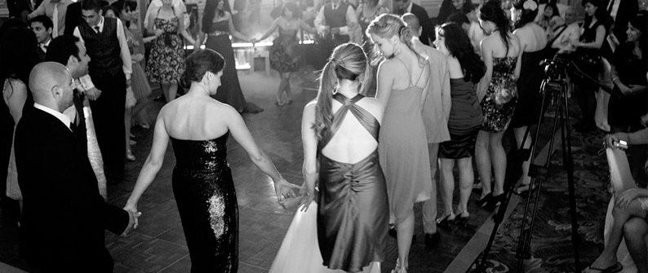
B3 Wedding of the Painted dolls – Grade 2 ballet
Bride (Elsie) – White Dress, Pink tights
Bridesmaids Pink dress - (Aurelia, Ava, Emilie A, Emily R, Hannah, Maddie, Olivia B) – Pink Dress, Pink tights
I will order these dresses.
Evening guests (Adrija, Felicity, Gracie, Jorja, Keela, Maddison, Olivia G, Rosie) – Buy your own – Suitable evening wear for a wedding that you can dance in, not too long.
Priest (Lana) – Buy your own
Groom – (Ruby) – Buy your own
Pink ballet shoes
(Deposit has been returned to your account in Class manager if buying your own)

Slide 18
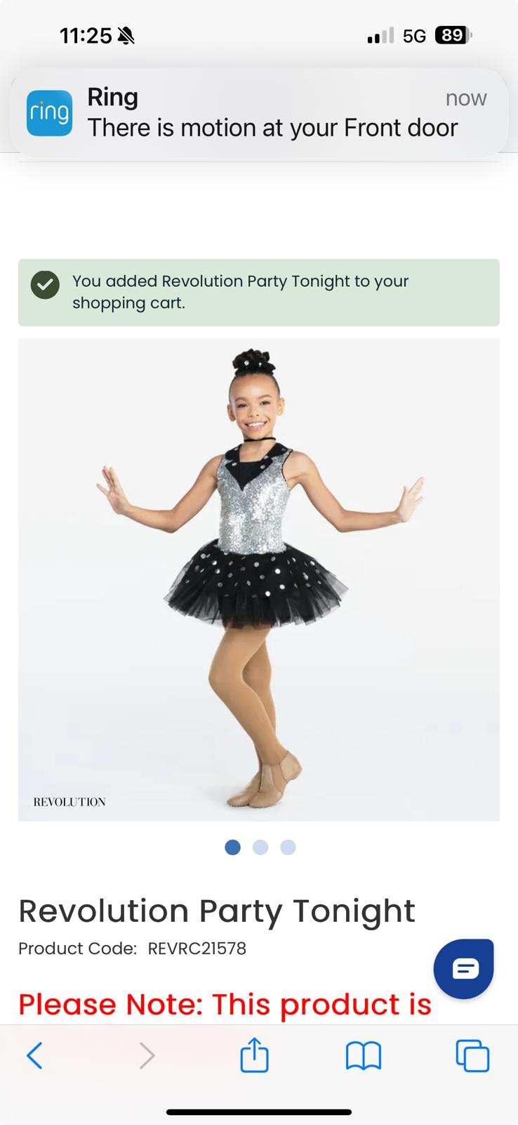
B4 Trio of tappers – Grade 4 Tap
Black tap shoes
Black fishnets
Hair - pony

Slide 19
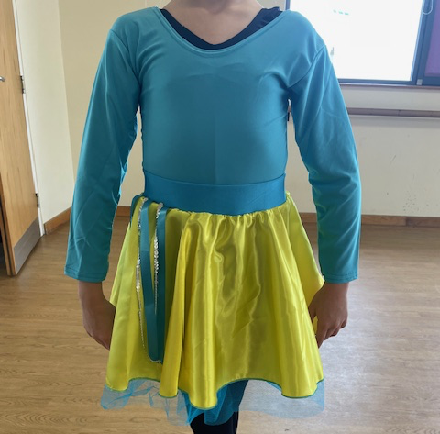
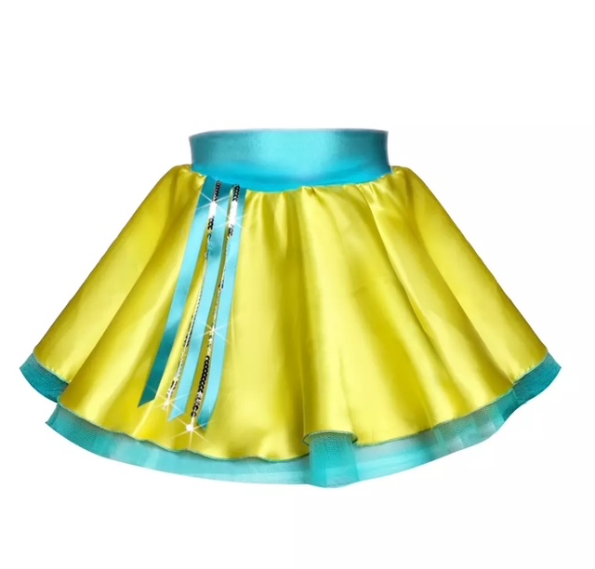
B5 Singing in the Rain – Grade 1 Tap
Black Tap Shoes
White ankle socks with lace frill
Hair two plaits – hair colour, matching bobbles

Slide 20

B6 Mario Cart – Prelim modern
Costume picture coming soon

Slide 21
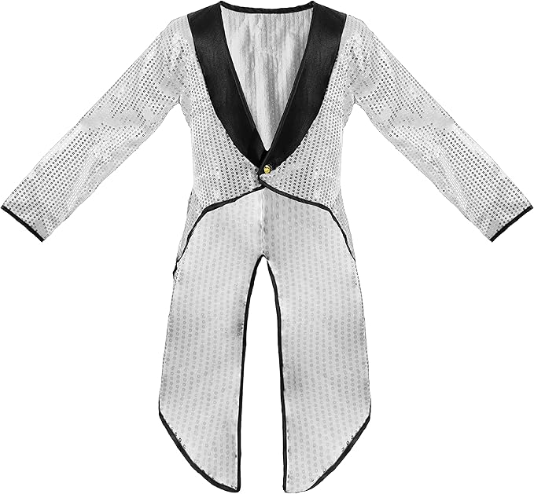
B7 Top Hats and Tails – Grade 3 Tap
Black tap shoes
Black leotard
Black dance shorts
Black fishnets
Hair – low pony

Slide 22
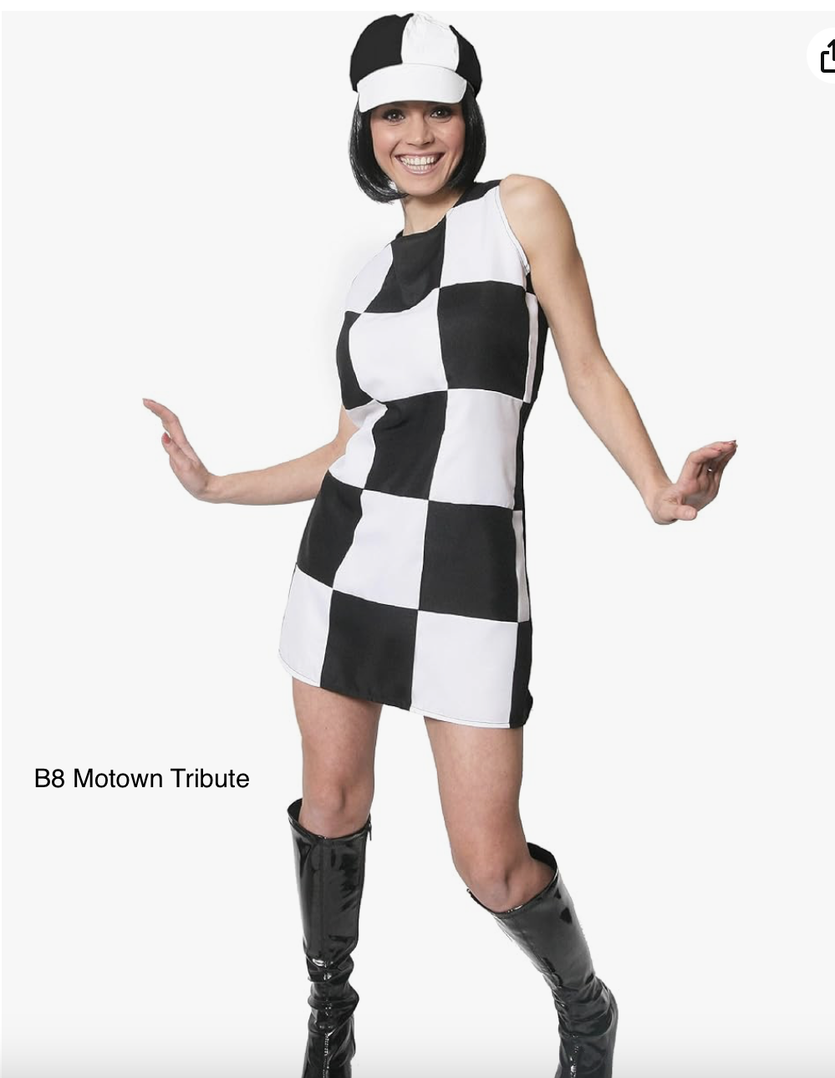
B8 Motown Tribute – Senior Modern
Black dance shorts
Flesh tights
Character Shoes
Hair - to be discussed

Slide 23
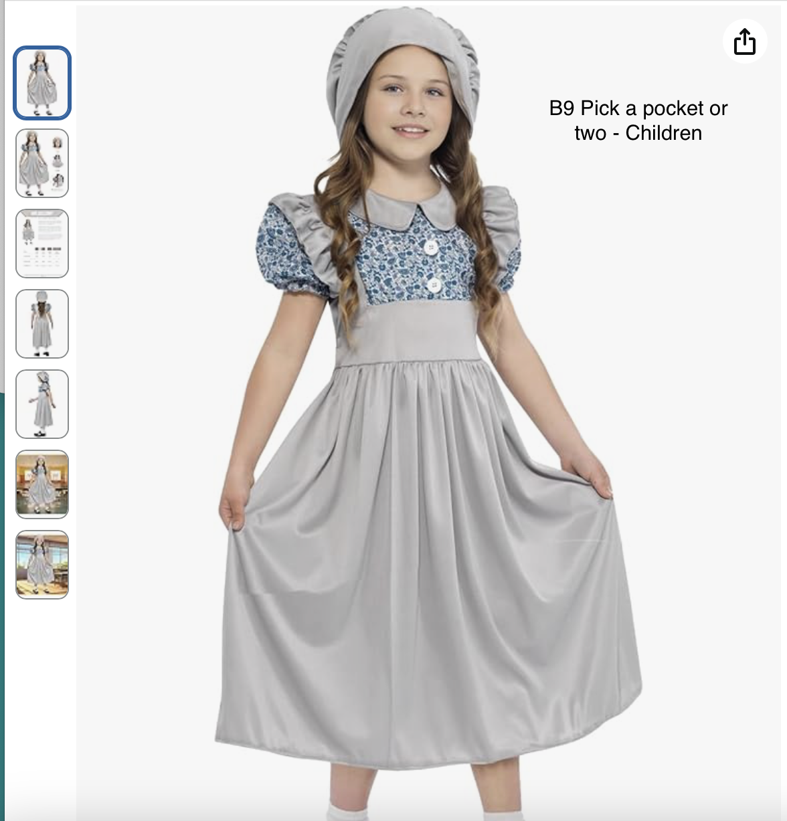
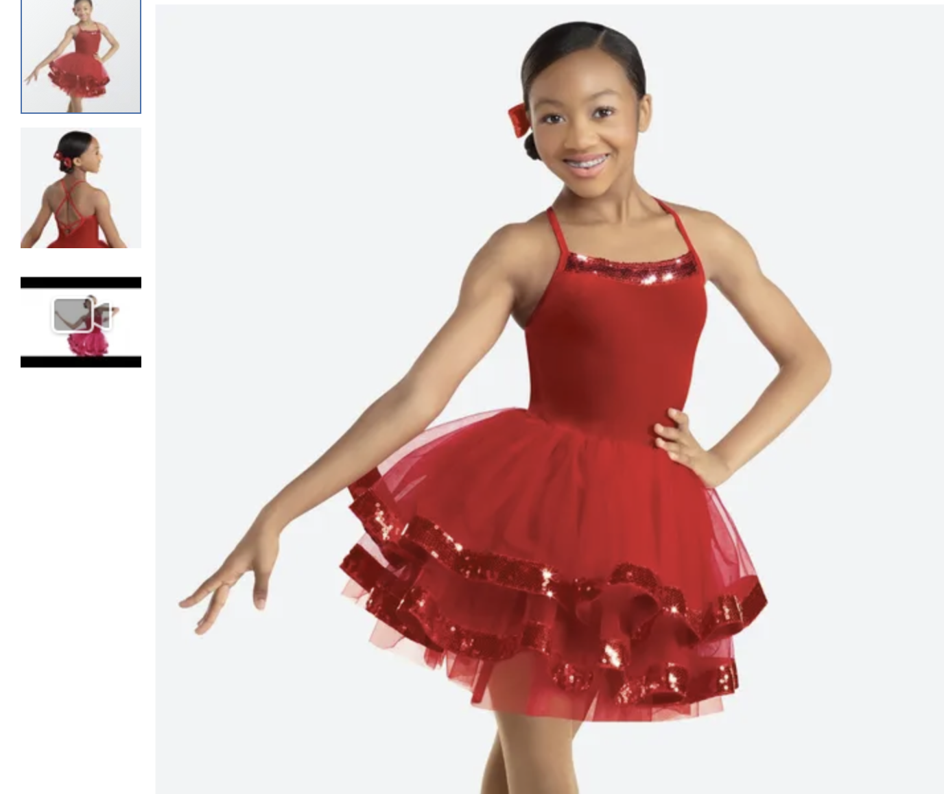
B9 Pick a Pocket or Two – Brigstock prelim and Grade 1 Ballet
Posh Girls ( Jessica, Mia, Lilly Mae and Aiyla Mae) – Red Dress
Pick pocket’s – (Paisleigh, Sophia, Phoebe, Zofia, Petra, Ada & Ruby) – Blue/Grey dress
Pink ballet shoes
White ankle socks with lace frill Hair – Posh girls buns,
Pick Pocket - neat hair
Posh Girls ( Jessica, Mia, Lilly Mae and Aiyla Mae) – Red Dress

Slide 24
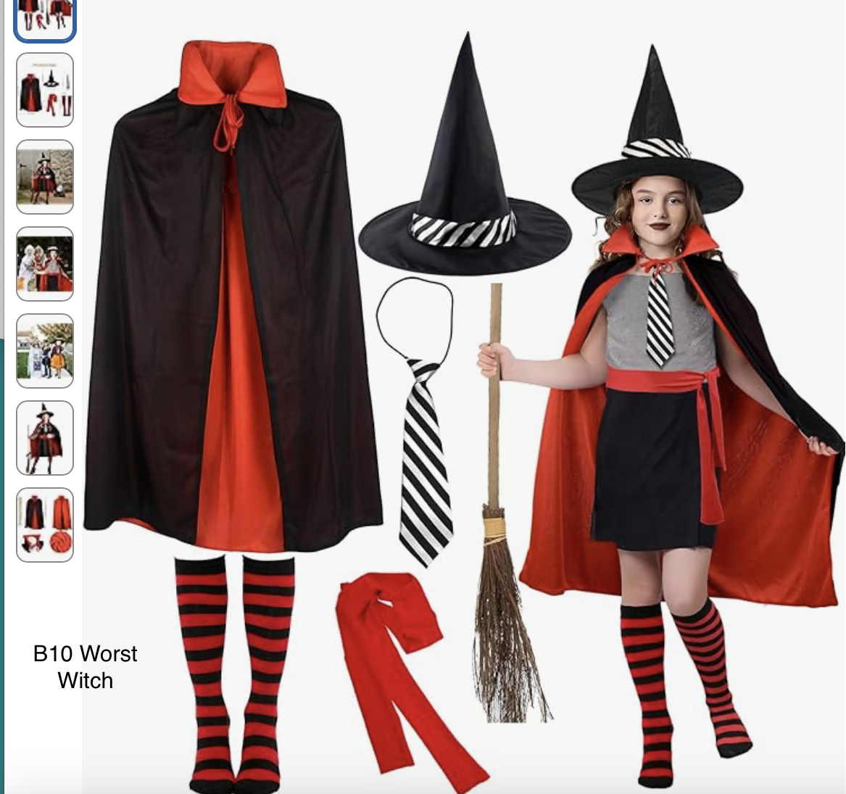
B10 Worst Witch – Grade 1 Ballet
Black usual dance wear – leotard & Ballet skirt.
No tights – wear the stripy socks
Pink ballet shoes
Hair 2 plaits

Slide 25
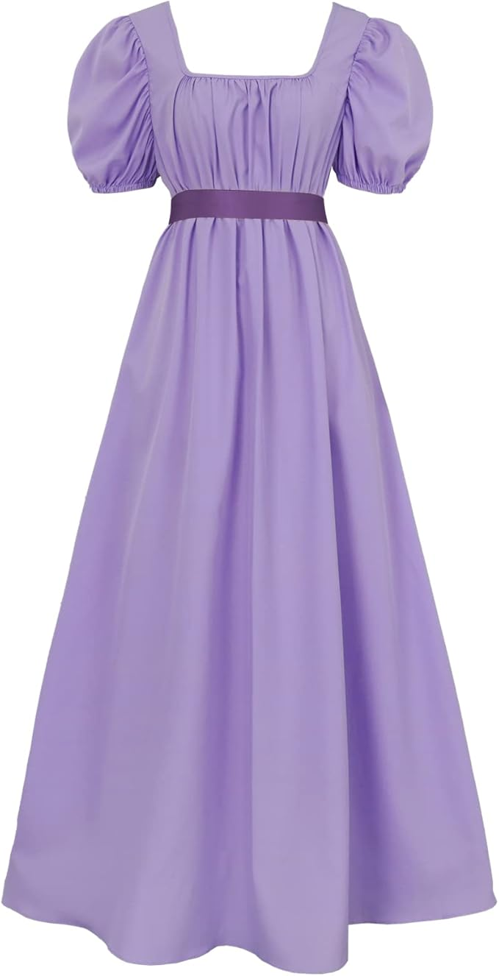
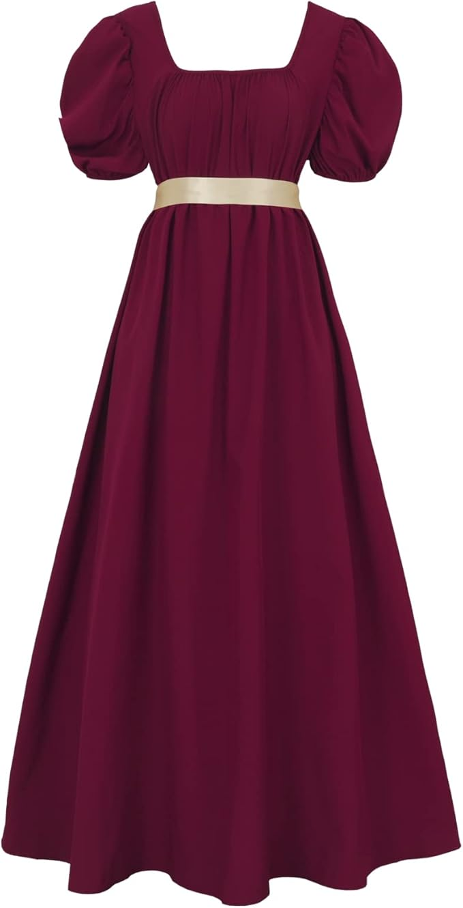
B11 Bridgeton – Adult Ballet
Pink ballet shoes
Pink tights
Hair – to be discussed

Slide 26
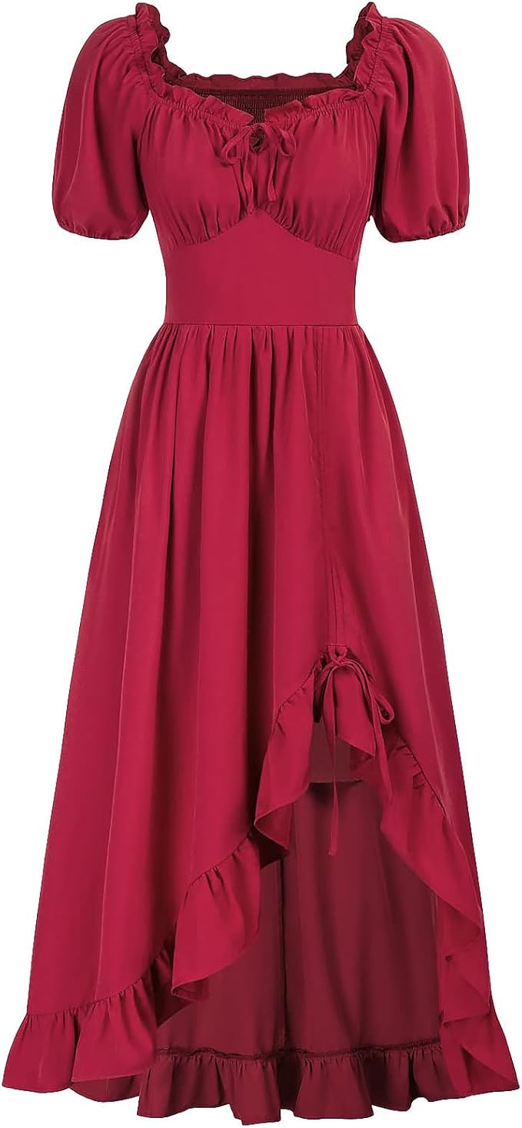
B12 Ompa Pah Pah – Brigstock Grade 4&5 Ballet
Pink ballet shoes
Pink ballet tights
Hair – half up half down

Slide 27
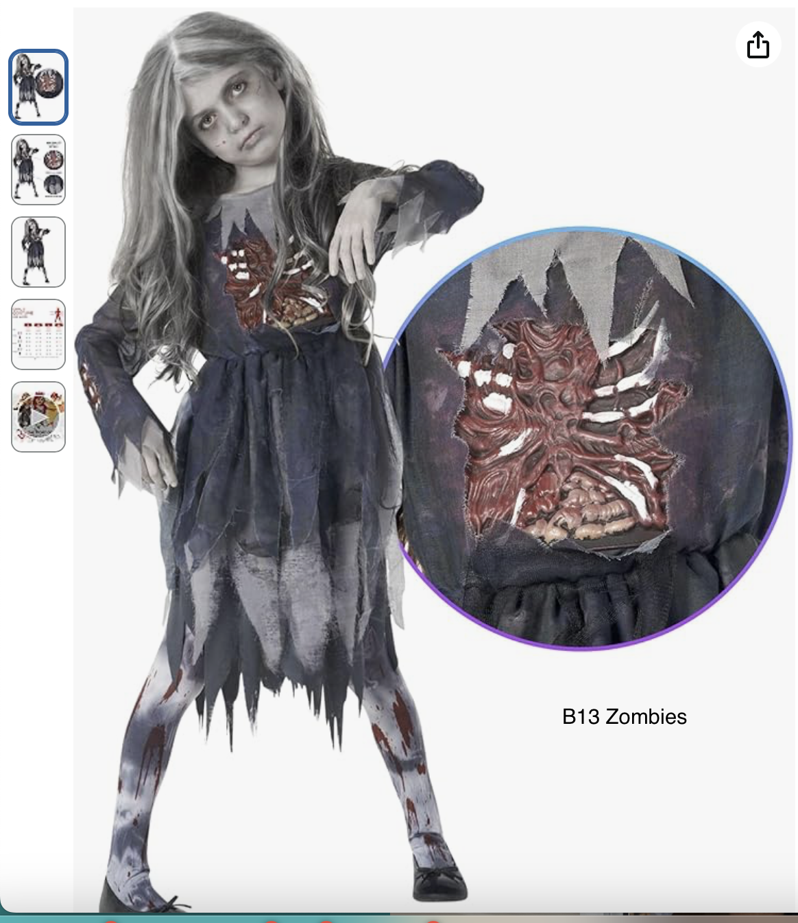
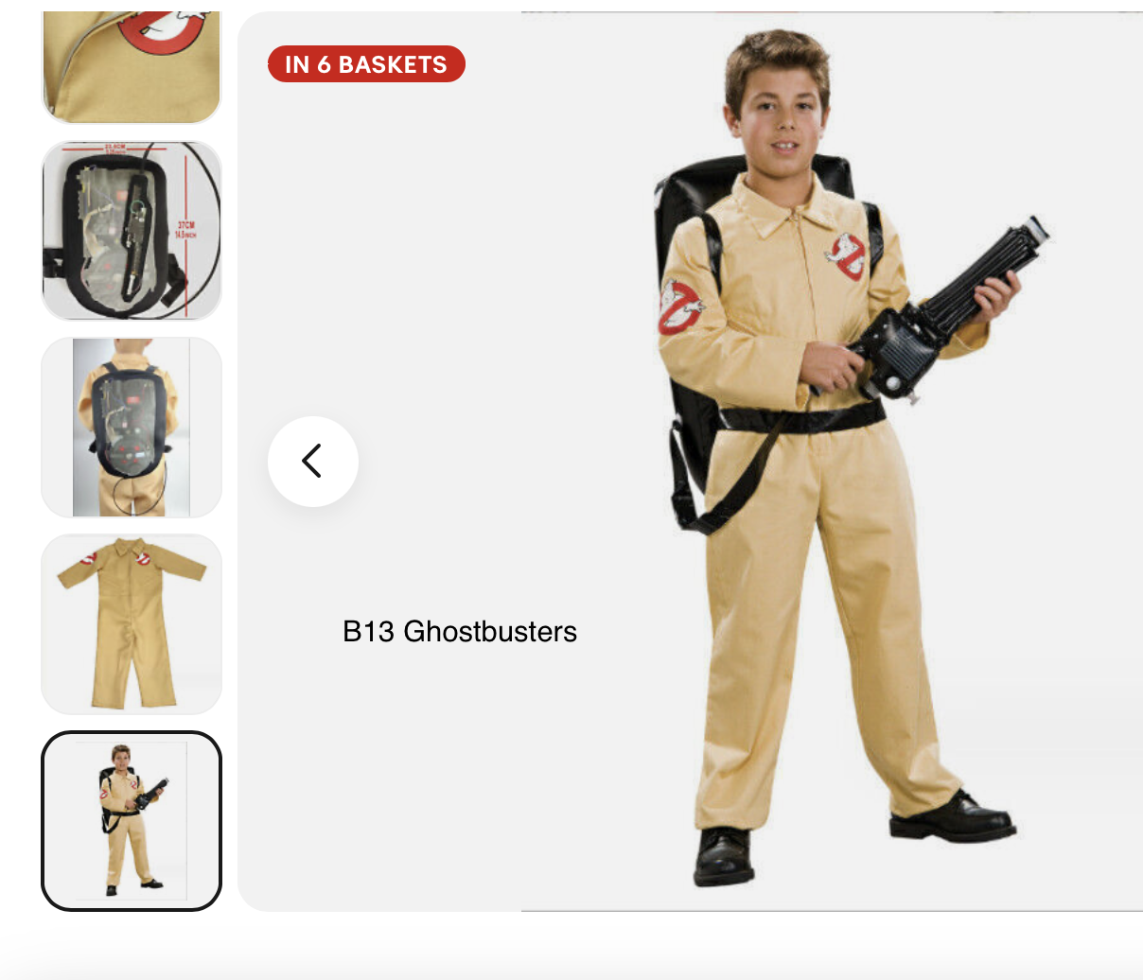
B13 Zombies and Ghostbusters – Class and Grade one gymnastics dance
Zombies – Florence, Olivia, Lucienne, Alina, Paisleigh, Primrose
Ghostbusters – Sarah, Paige, Ruby, Hannah, Maddison, Lilly Mae and Aiyla Mae
Bare feet
Hair - zombies messy/ untidy
Hair – Ghostbusters low pony

Slide 28
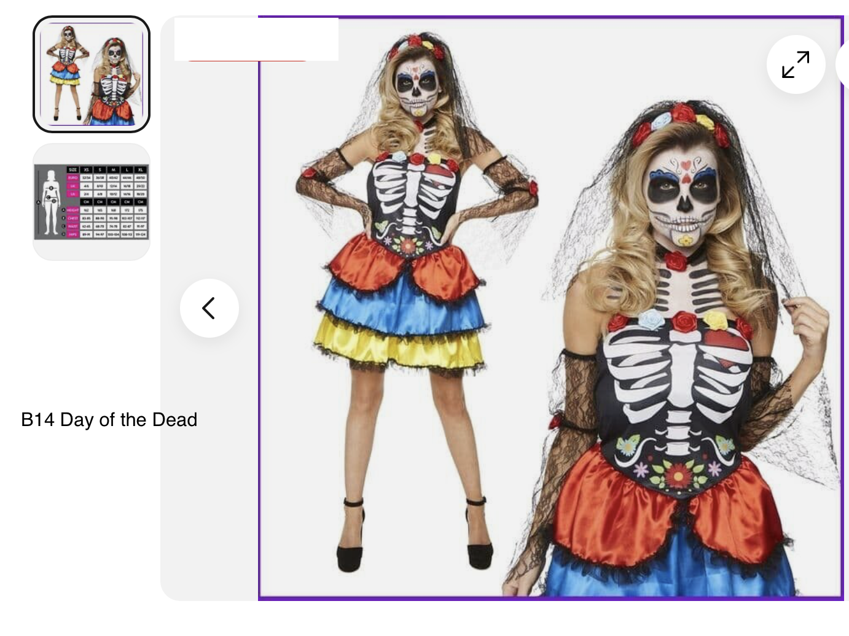
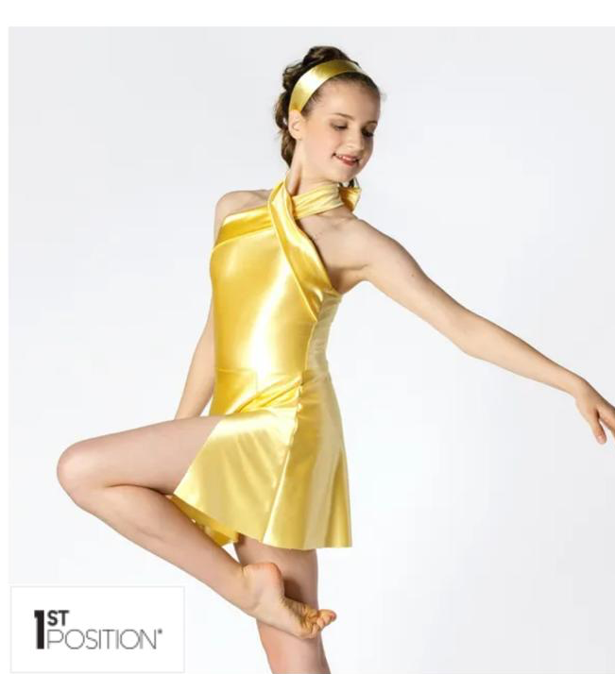
B14 Day of the Dead and Bond Girls
Day of the Dead – Isla, Katie, Nixie, Felicity, Aurelia, Amelia, Holly and Emilie
Black footless tights
Bond Girls – Lacey, Bethany, Amy, Isla and Evie
Bare feet
Day of the dead hair – pony
Bond girls – pony

